Slide 1

Chapter Six
Descriptive Research Design: Survey and Observation

Slide 2
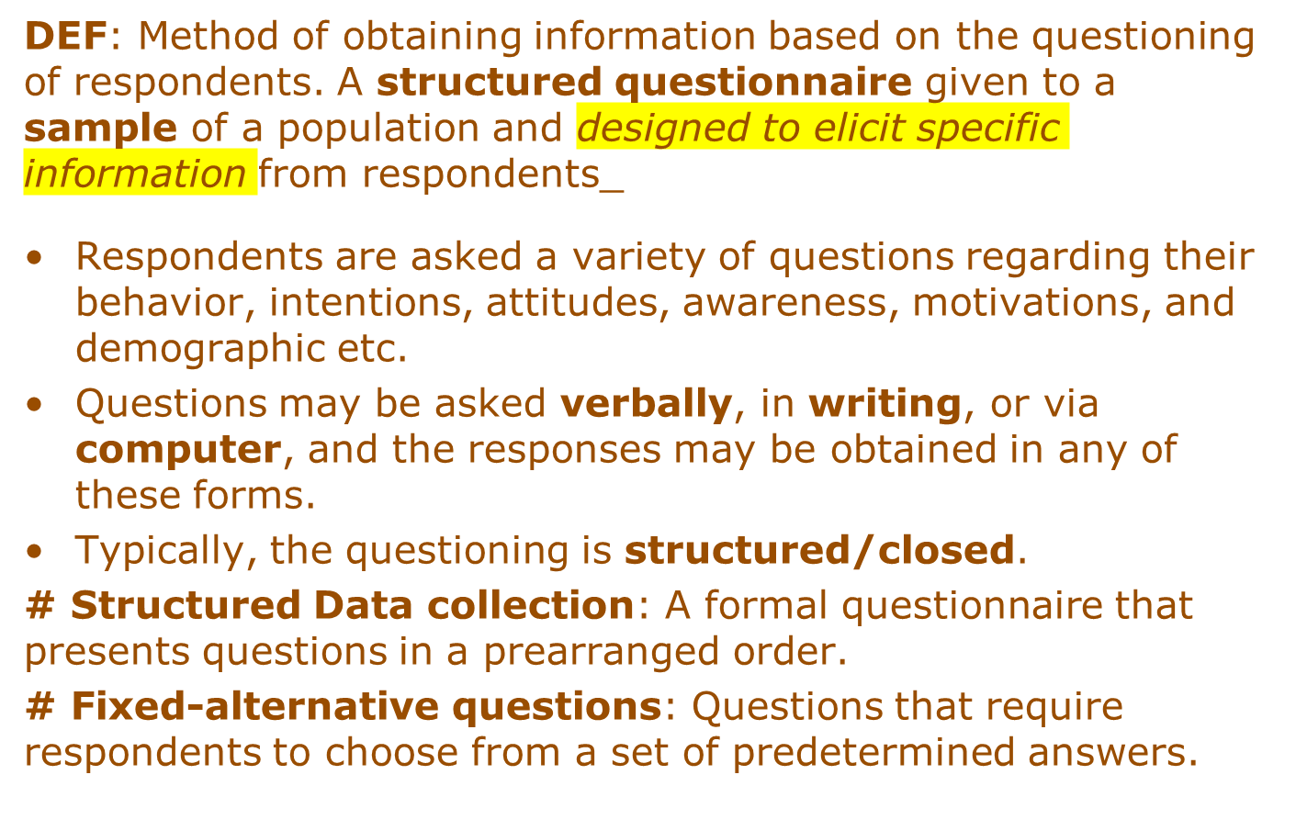
Survey Methods

Slide 3
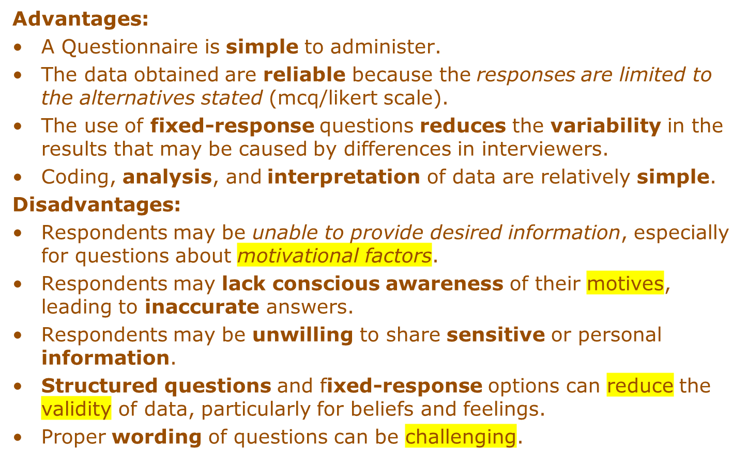
Survey Methods

Slide 4





Survey Methods
Telephone
Electronic
In-Home
Internet
Computer-Assisted Telephone Interviewing
Notes:
# advantage of MALL-INTERCEPT interview is more efficient for the respondent to come to the interviewer than for the interviewer to go to the respondent. This method has become increasingly popular and there are several hundred permanent mall research facilities.
# personal in home: interviewer’s task is to contact the respondents, ask the questions, and record the responses. In recent years, the use of personal in-home interviews has declined due to its high cost.
# CAPI : The respondent answers a questionnaire directly on a computer using a keyboard or mouse. User-friendly software designs clear questions and provides help screens and polite error messages.

Slide 5
Some Decisions Related to the Mail Interview Package
Outgoing Envelope
Outgoing envelope Size, color, return address
Postage Method of addressing
Cover Letter
Sponsorship Type of appeal Postscript
Personalization Signature
Questionnaire
Length Size Layout Format
Content Reproduction Color Respondent anonymity
Return Envelope
Type of envelope Postage
Incentives
Monetary versus non-monetary Prepaid versus promised amount

Slide 6
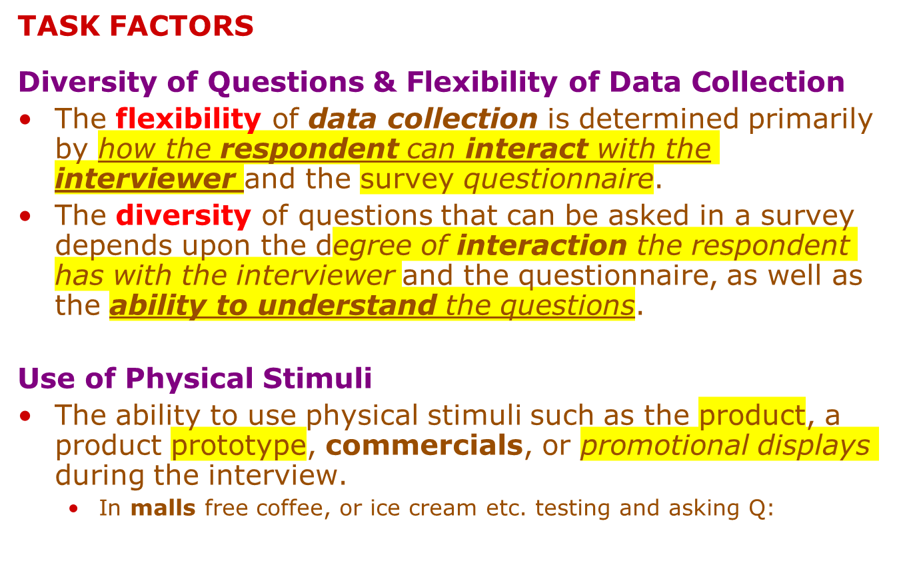
Notes:
#Because the respondent and the interviewer meet face to face, the interviewer can administer complex questionnaires, explain and clarify difficult questions, and even utilize unstructured techniques.
#

Slide 7
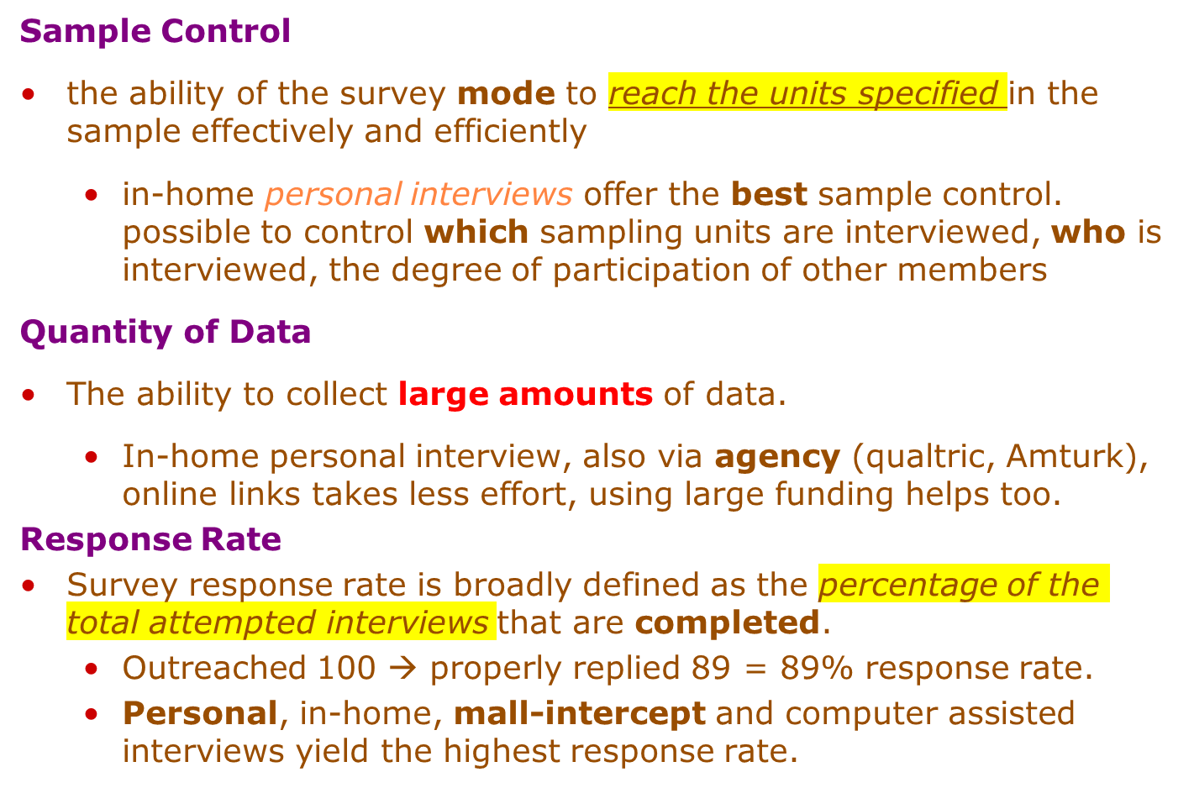
Notes:
Quantity of Data: In contrast to in-home interviews, mall intercept and CAPI provide only moderate amounts of data. naire that took more than an hour to complete.
Traditional telephone interviews and CATI result in the most limited quantities of data.

Slide 8
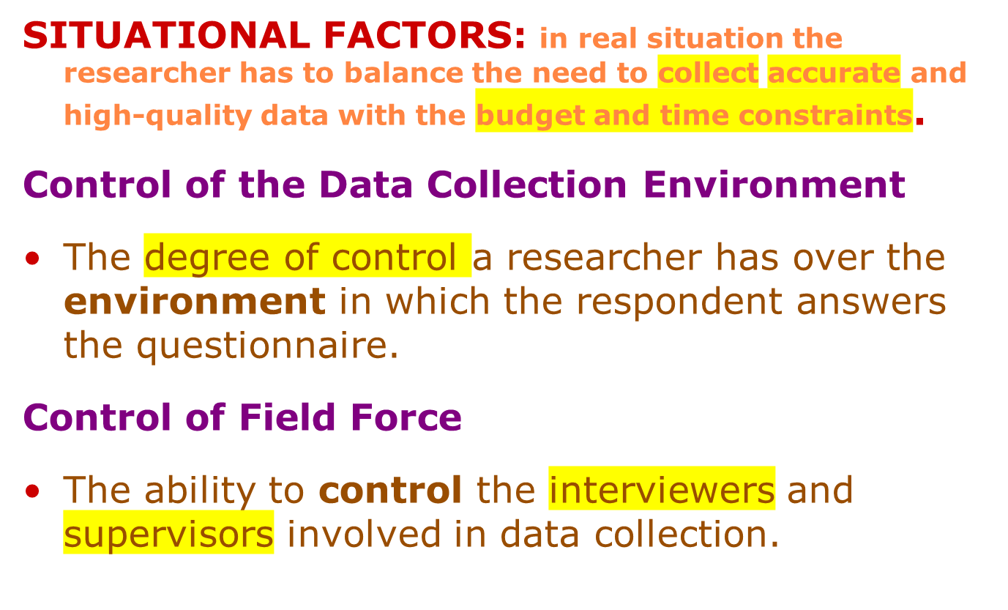
Notes:
# Data Collection Environment:: Personal interviews conducted at central locations (mall intercept and CAPI) offer the greatest degree of environmental control. For example, the researcher can set up a special facility for demonstrating the product. In-home personal interviews offer moderate to high control because the interviewer is present
# Control of Field Force:: in-home personal interviews are problematic in this respect. Since many interviewers work in many different locations, continual
supervision is impractical.

Slide 9
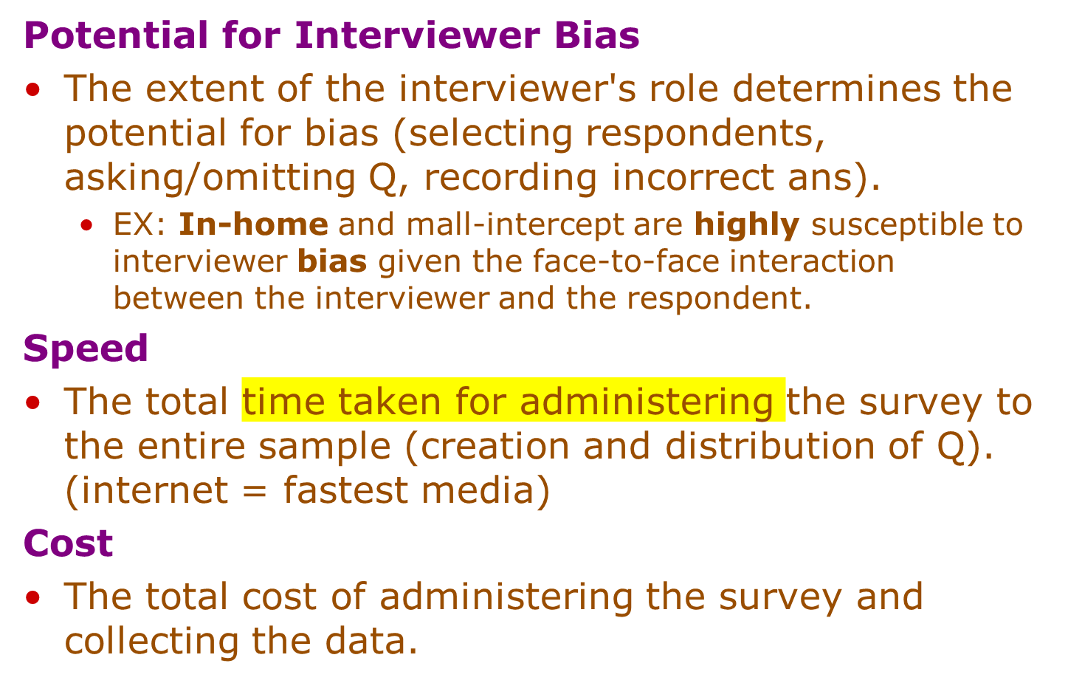
Criteria for Evaluating Survey Methods
Notes:
COST::
For large samples, the cost of Internet surveys is the lowest. Printing, mailing, keying, and interviewer costs are eliminated, and the incremental costs of each respondent are typically low, so studies with large numbers of respondents can be done at substantial savings compared to mail, telephone, or personal surveys. However, when the sample size is small, the programming costs can be substantial and other low-cost methods such as mail and e-mail surveys should also be considered. Personal interviews tend to be the most expensive mode of data collection per completed response.

Slide 10
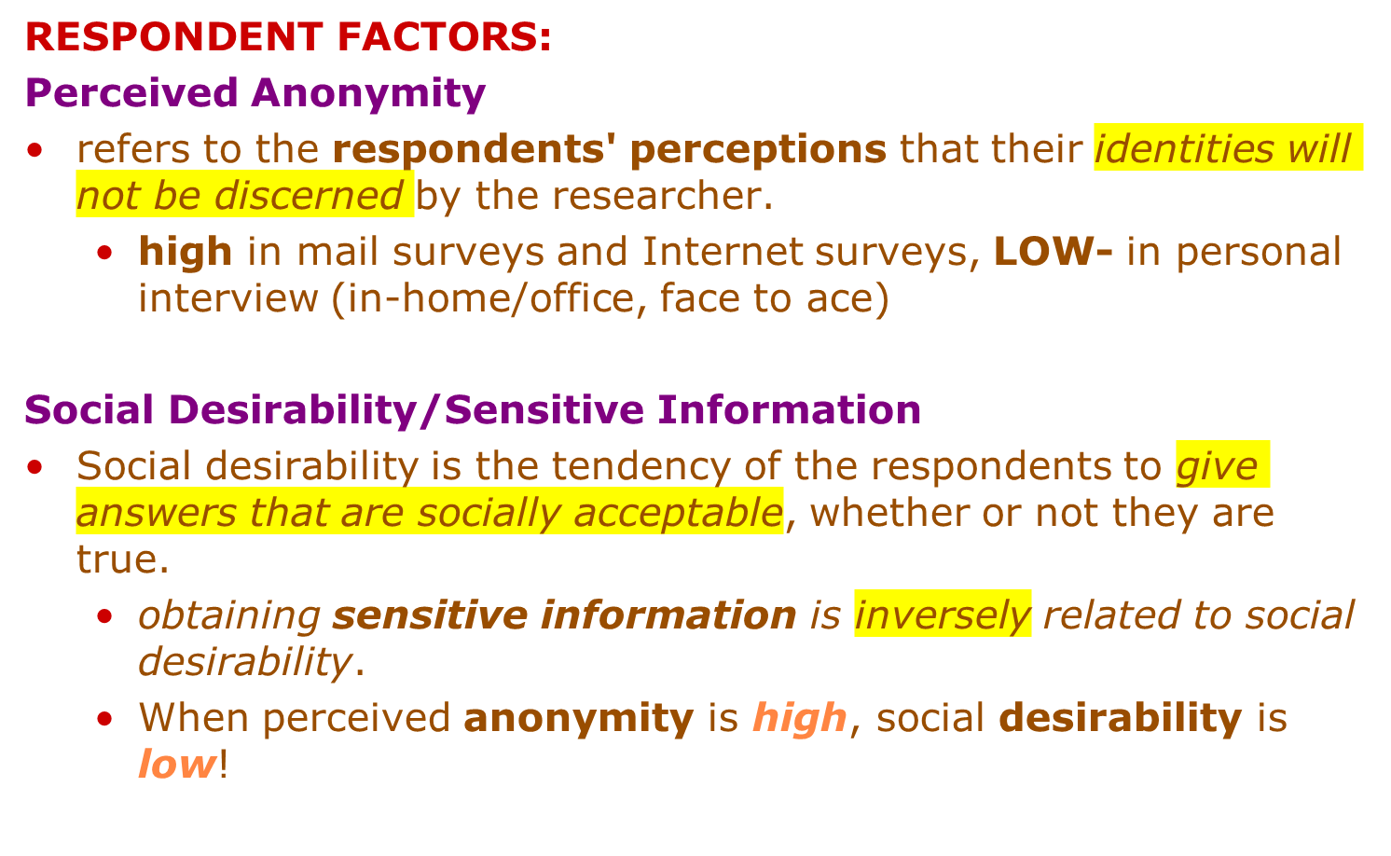
Criteria for Evaluating Survey Methods

Slide 11
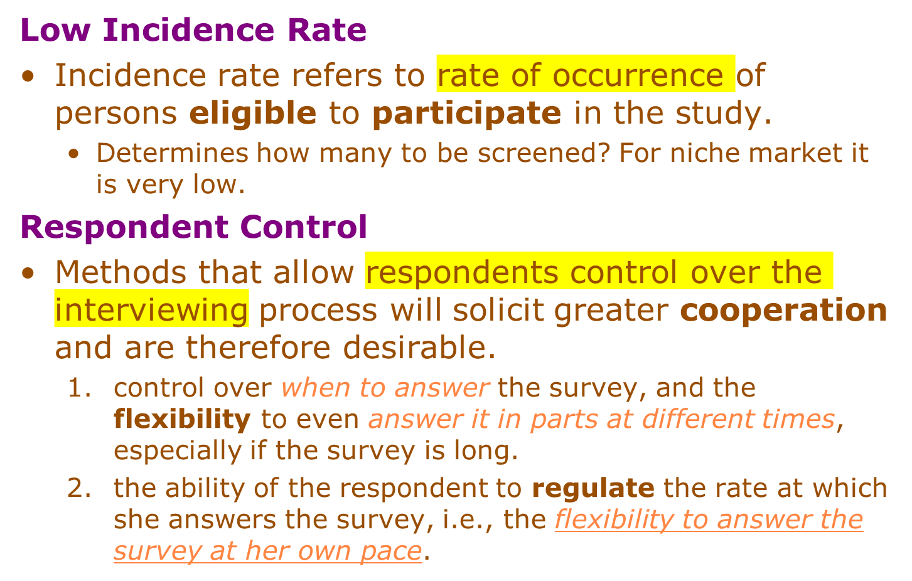
Criteria for Evaluating Survey Methods
Notes:
## incidence rate determines how many contacts need to be screened for a given sample size requirement. There are times when the researcher is faced with a situation where the incidence rate of the survey respondents is low. This is generally the case when the population represents a niche or a highly targeted market, rather than the general population.
# Respondent control: Some control is lost in Internet surveys, because in random pop-up surveys the respondents do not have the flexibility of answering at a later
time. However, Internet surveys can be designed to allow respondents to come back and complete them, resulting in moderate to high rating

Slide 12
A Comparative Evaluation of Survey Methods
Criteria |  |  |  | Telephone/ | In-Home | Mall Intercept |  | CAPI | Mail Surveys | Mail Panels | E-Mail | Internet
 |  |  |  | CATI | Interviews | Interviews
TASK FACTORS
Diversity of questions and flexibility |  |  |  | Low | High | High | Moderate |  | Moderate | Moderate | Moderate | Moderate
 |  |  |  | to moderate |  |  | to high |  |  |  |  | to high
Use of physical stimuli |  |  |  | Low | Moderate | High | High |  | Moderate | Moderate | Low | Moderate
 |  |  |  |  | to high
Sample Control |  |  |  | Moderate to | Potentially | Moderate | Moderate |  | Low | Moderate to | Low | Low to
 |  |  |  | high | high |  |  |  |  | high |  | moderate
Quantity of data |  |  |  | Low | High | Moderate | Moderate |  | Moderate | High | Moderate | Moderate
Response rate |  |  |  | Moderate | High | High | High |  | Low | High | Low | Very low

Slide 13
A Comparative Evaluation of Survey Methods
Criteria |  |  | Telephone | In-Home | Mall-Intercept | CAPI | Mail Surveys | Mail Panels | E-Mail | Internet
 |  |  | CATI | Interviews | Interviews
SITUATIONAL FACTORS
Control of data collection environment |  |  | Moderate | Moderate | High | High | Low | Low | Low | Low
 |  |  |  | to high
Control of field force |  |  | Moderate | Low | Moderate | Moderate | High | High | High | High
Potential for interviewer bias |  |  | Moderate | High | High | Low | None | None | None | None
Speed |  |  | High | Moderate | Moderate | Moderate | Low | Low | High | Very
 |  |  |  |  | to high | to high |  | to moderate |  | high
Cost |  |  | Moderate | High | Moderate | Moderate | Low | Low | Low | Low
 |  |  |  |  | to high | to high |  | to moderate

Slide 14
A Comparative Evaluation of Survey Methods
Criteria |  |  | Telephone / | In-Home | Mall-Intercept | CAPI | Mail Surveys | Mail Panels | E-Mail | Internet
 |  |  | CATI | Interviews | Interviews
Table 6.2
RESPONDENT FACTORS
Perceived anonymity of the respondent |  |  | Moderate | Low | Low | Low | High | High | Moderate | High
Social desirability |  |  | Moderate | High | High | Moderate | Low | Low | Moderate | Low
 |  |  |  |  |  | to High
Obtaining sensitive information |  |  | High | Low | Low | Low | High | Moderate | Moderate | High
 |  |  |  |  |  | to moderate |  | to high
Low incidence rate |  |  | High | Low | Low | Low | Moderate | Moderate | Moderate | High
Respondent control |  |  | Low | Low | Low | Low | High | High | High | Moderate
 |  |  | to moderate |  |  |  |  |  |  | to high

Slide 15
Observation Methods Structured Versus Unstructured Observation
For structured observation, the researcher specifies in detail what is to be observed and how the measurements are to be recorded, e.g., an auditor performing inventory analysis in a store.
In unstructured observation, the observer monitors all aspects of the phenomenon that seem relevant to the problem at hand, e.g., observing children playing with new toys.

Slide 16
Observation Methods Disguised Versus Undisguised Observation
In disguised observation, the respondents are unaware that they are being observed. Disguise may be accomplished by using one-way mirrors, hidden cameras, or inconspicuous mechanical devices. Observers may be disguised as shoppers or sales clerks.
In undisguised observation, the respondents are aware that they are under observation.

Slide 17
Observation Methods
Natural Versus Contrived Observation
Natural observation involves observing behavior as it takes places in the environment. For example, one could observe the behavior of respondents eating fast food at Burger King.
In contrived observation, respondents' behavior is observed in an artificial environment, such as a test kitchen.

Slide 18

A Classification of Observation Methods
Fig. 6.3
Classifying
Observation
Methods
Observation Methods
Personal Observation
Mechanical Observation
Audit
Content Analysis
Trace Analysis

Slide 19
Observation Methods: Personal Observation
A researcher observes actual behavior as it occurs.
The observer does not attempt to manipulate the phenomenon being observed but merely records what takes place.
For example, a researcher might record traffic counts and observe traffic flows in a department store.

Slide 20
Observation Methods: Mechanical Observation
Do not require respondents' direct participation.
  The AC Nielsen audimeter
  Turnstiles that record the number of people entering or leaving a building.
  On-site cameras (still, motion picture, or video)
  Optical scanners in supermarkets
Do require respondent involvement.
  Eye-tracking monitors
  Pupilometers
  Psychogalvanometers
  Voice pitch analyzers
  Devices measuring response latency

Slide 21
Observation Methods: Audit
The researcher collects data by examining physical records or performing inventory analysis.
Data are collected personally by the researcher.
The data are based upon counts, usually of physical objects.
Retail and wholesale audits conducted by marketing research suppliers were discussed in the context of syndicated data in Chapter 4.

Slide 22
Observation Methods: Content Analysis
The objective, systematic, and quantitative description of the manifest content of a communication.
The unit of analysis may be words, characters (individuals or objects), themes (propositions), space and time measures (length or duration of the message), or topics (subject of the message).
Analytical categories for classifying the units are developed and the communication is broken down according to prescribed rules.

Slide 23
Observation Methods: Trace Analysis
Data collection is based on physical traces, or evidence, of past behavior.
The selective erosion of tiles in a museum indexed by the replacement rate was used to determine the relative popularity of exhibits.
The number of different fingerprints on a page was used to gauge the readership of various advertisements in a magazine.
The position of the radio dials in cars brought in for service was used to estimate share of listening audience of various radio stations.
The age and condition of cars in a parking lot were used to assess the affluence of customers.
The magazines people donated to charity were used to determine people's favorite magazines.
Internet visitors leave traces which can be analyzed to examine browsing and usage behavior by using cookies.

Slide 24

A Comparative Evaluation of Observation Methods
Table 6.3
Criteria Personal Mechanical Audit Content Trace
Observation Observation Analysis Analysis Analysis
Degree of structure Low Low to high High High Medium
Degree of disguise Medium Low to high Low High High
Ability to observe High Low to high High Medium Low
in natural setting
Observation bias High Low Low Medium Medium
Analysis bias High Low to Low Low Medium
Medium
General remarks Most Can be Expensive Limited to Method of
flexible intrusive commu- last resort
nications

Slide 25
Relative Advantages of Observation
They permit measurement of actual behavior rather than reports of intended or preferred behavior.
There is no reporting bias, and potential bias caused by the interviewer and the interviewing process is eliminated or reduced.
Certain types of data can be collected only by observation.
If the observed phenomenon occurs frequently or is of short duration, observational methods may be cheaper and faster than survey methods.

Slide 26
Relative Disadvantages of Observation
The reasons for the observed behavior may not be determined since little is known about the underlying motives, beliefs, attitudes, and preferences.
Selective perception (bias in the researcher's perception) can bias the data.
Observational data are often time-consuming and expensive, and it is difficult to observe certain forms of behavior.
In some cases, the use of observational methods may be unethical, as in observing people without their knowledge or consent.
It is best to view observation as a complement to survey methods, rather than as being in competition with them.

Slide 27

A Comparative Evaluation of Survey Methods for International Marketing Research
Table 6.4
Criteria Telephone Personal Mail Electronic
High sample control + + - -
Difficulty in locating + - + +
respondents at home
Inaccessibility of homes + - + +
Unavailability of a large + - + +
pool of trained interviewers
Large population in rural areas - + - -
Unavailability of maps + - + +
Unavailability of current - + - +
telephone directory
Unavailability of mailing lists + + - +
Low penetration of telephones - + + -
Lack of an efficient postal system + + - +
Low level of literacy - + - -
Face-to-face communication culture - + - -
Poor access to computers & Internet ? + ? -
Note: A (+) denotes an advantage, and a (–) denotes a disadvantage.

Slide 28
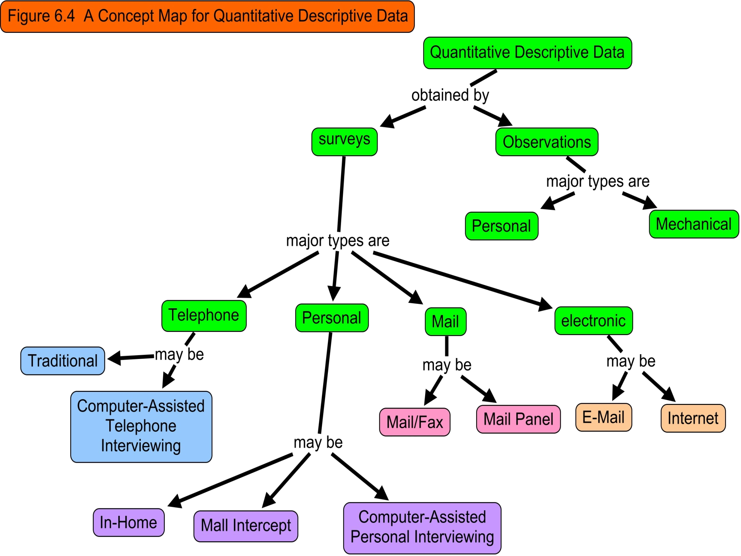

Slide 29

All rights reserved. No part of this publication may be reproduced, stored in a retrieval system, or transmitted, in any form or by any means, electronic, mechanical, photocopying, recording, or otherwise, without the prior written permission of the publisher. Printed in the United States of America.
Copyright © 2010 Pearson Education, Inc. publishing as Prentice Hall

